Slide 1
Selected Topics in Computational Intelligence I
Session Enrichment 1
Solving Traveling Salesman Problem

Slide 2
Agenda
TSP using ACO
TSP using GA

Slide 3
The travelling salesman problem
Suppose, we are going to travel by car in Western and Central Europe. We want to produce an optimal itinerary for visiting all major cities and returning home.
This problem is well known as the travelling salesman problem. Given a finite number of cities, N, and the cost of travel (or the distance) between each pair of cities, we need to find the cheapest way (or the shortest route) for visiting each city exactly once and returning to the starting point.

Slide 4
The TSP is represented in numerous transportation and logistics applications such as
arranging routes for school buses to pick up children in a school district,
delivering meals to home-bound people,
scheduling stacker cranes in a warehouse,
planning truck routes to pick up parcel post and many others.
A classic example of the TSP is the scheduling of a machine to drill holes in a circuit board.

Slide 5
How does a genetic algorithm solve the travelling salesman problem?
First, we need to decide how to represent a route of the salesman.
The most natural way of representing a route is the path representation.
Each city is given an alphabetic or numerical name, the route through the cities is represented as a chromosome, and appropriate genetic operators are used to create new routes.
Suppose we have nine cities named from 1 to 9.
In a chromosome, the order of the integers represents the order in which the cities will be visited by the salesman.

Slide 6
An example of the salesman’s route

Slide 7
TSP using ACO
First proposed by M. Dorigo, 1992
Heuristic optimization method inspired by biological systems
Multi-agent approach for solving difficult combinatorial optimization problems
Traveling Salesman, vehicle routing, sequential ordering, graph coloring, routing in communications networks

Slide 8
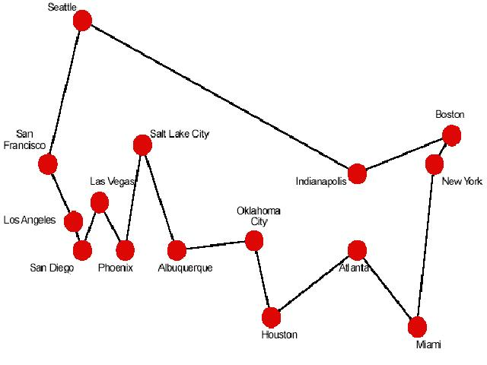
Traveling Salesman Problem(TSP)-1
The TSP requires a salesman to find the shortest route between the given cities and return to the starting city, while keeping in mind that each city can be visited only once
Goes through every city once and only once
Minimizes the total distance.

Slide 9
Traveling Salesman Problem(TSP)-2
The TSP was chosen for many reasons :
1. It is a problem to which the ant colony metaphor
2. It is one of the most studied NP-hard problems in the combinatorial optimization
3. it is very easily to explain. So that the algorithm behavior is not obscured by too many technicalities.

Slide 10
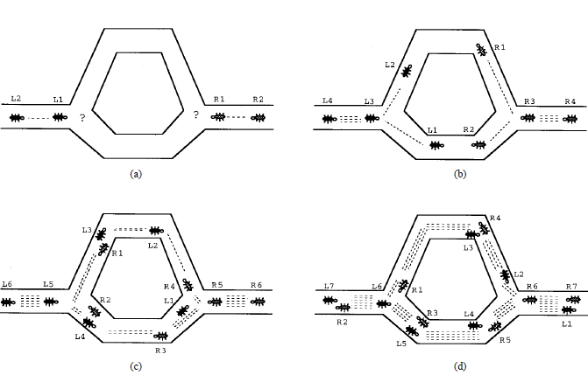
Ant System-3

Slide 11
AS-Parameter
Trail intensity is given by value of τ_{ij} which indicates the intensity of the pheromone on the trail segment, (ij)
Trail visibility is η_{ij} = 1/d_{ij}
The importance of the intensity in the probabilistic transition is α
The importance of the visibility of the trail segment is β
The trail persistence or evaporation rate is given as ρ
Q is a constant and the amount of pheromone laid on a trail segment employed by an Ant; this amount may be modified in various manners

Slide 12
AS-Probabilistic city
α= 0 city is chosen by Greedy (Closest city)
β=0 city is chosen by pheromone

Slide 13
Pheromone Updating
Using the tour length for the k-th Ant, L_{k}, the quantity of pheromone added to each edge belonging to the completed tour is given by
The pheromone decay in each edge of a tour is given by

Slide 14

Ant Colony System-1
ACS is developed from AS
Three different aspect :
the state transition rule provides a direct way to balance between exploration of new edges and exploitation of a priori and accumulated knowledge about the problem.
if ant positioned on r choose the city s to move by rule
q= random number [0..1]
qo= 0<qo<1 →user
S= random variable according probability in AS

Slide 15
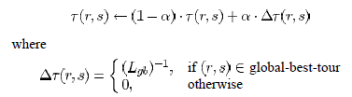
ACS-2 Three different AS dan ACS
2. Update Global Rule
Only the globally best ant is allowed to deposit pheromone. Updated is done after all ants have complete their tours
The pheromone is updated by :
0<α<1 is the pheromone decay
Lgb= is the length of globally best tour from the beginning of trial

Slide 16

ACS-3 Three different AS dan ACS
3. While building tour, ant visit adge and change their pheremone level by the local updating rule.
The purpose is shuffle the tours, so that the early cities in one ant’s tour may be explored the others ant.
Make the desirability of edge change dynmically
This is make avoiding from the same tour

Slide 18
How does the crossover operator works?
The crossover operator in its classical form cannot be directly applied to the TSP. A simple exchange of parts between two parents would produce illegal routes containing duplicates and omissions – some cities would be visited twice while some others would not be visited at all:

Slide 19
Crossover operators for the TSP

Slide 20
How does the mutation operator works?
There are two types of mutation operators: reciprocal exchange and inversion.
The reciprocal exchange operator simply swaps two randomly selected cities in the chromosome.
The inversion operator selects two random points along the chromosome string and reverses the order of the cities between these points.

Slide 21
Mutation operators for the TSP

Slide 22
How do we define a fitness function in the TSP?
The fitness of each individual chromosome is determined as the reciprocal of the route length.
In other words, the shorter the route, the fitter the chromosome.

Slide 23
Performance graph and the best salesman’s route created in a population of 20 chromosomes after 100 generations
Distance

Slide 24
Performance graphs and the best routes created in a population of 200 chromosomes: mutation rate is 0.001

Slide 25
Performance graphs and the best routes created in a population of 200 chromosomes: mutation rate is 0.01

Slide 26
References
Enterprise Architecture at Work Modelling, Communication and Analysis,: Lankhorst, Marc
How to Survive in the Jungle of Enterprise Architecture Frameworks: Creating or Choosing an Enterprise Architecture Framework, Jaap Schekkerman
An Introduction to Enterprise Architecture: Third Edition, Scott A. Bernard, AuthorHouse

